Slide 1
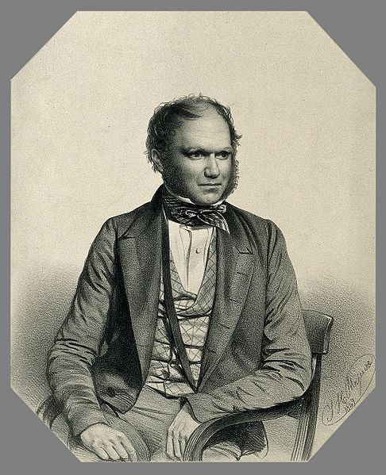
Hacking Darwin
Darwin Manuscripts Project, AMNH Research Library

Slide 2
Instructions: Understanding File names
The data are divided into folders that correspond to physical volumes filled with Darwin manuscripts & mounted on acid free paper.
Each folder corresponds to one DAR volume. Our database is organized on the same basis:
http://www.amnh.org/our-research/darwin-manuscripts-project/catalogues/union-catalogue/cambridge-university-library
The image file names give you the DAR volume number as well as the image numbers in the sequence in which the manuscripts were photographed. For example: MS-DAR-00205-00001-000-00047, corresponds to image 47 in the volume DAR 205.1
Darwin Project staff will translate the image file names into database page numbers.

Slide 3
Instructions: Making Matches
Search across the entire collection of 25540 images and group the images into five folders according to the five edge types, which are illustrated in the power point:
Saw tooth
Curved cut
Fuzzy
Very fuzzy
Torn
Find any matches between images in each of these folders.
Report your results in a spread sheet, where the file names for any two matched images appear in the same row: e.g.
MS-DAR-00205-00001-000-00047 | MS-DAR-00075-00000-000-00012

Slide 4
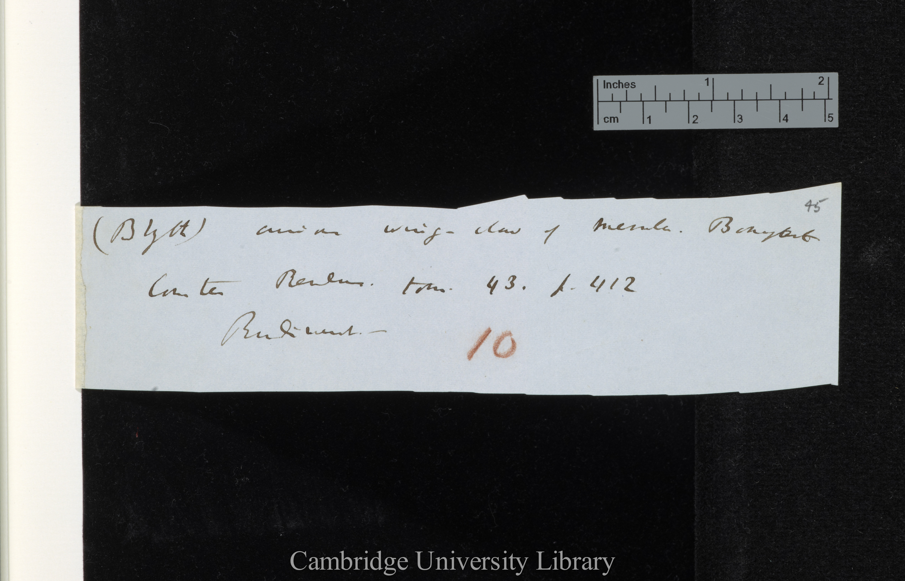
saw-tooth edgege
Notes:
DAR 205.1: 45 saw toothed

Slide 5
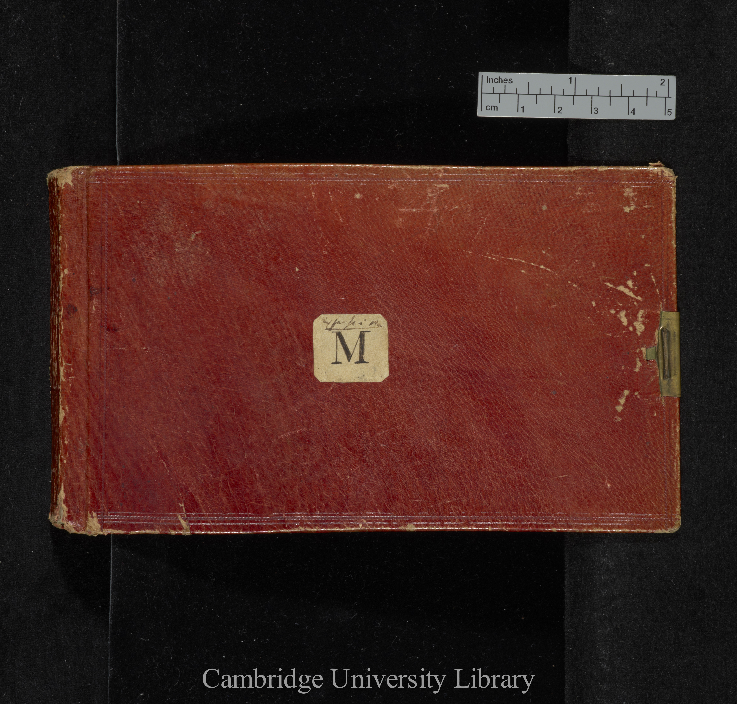
Notebook M

Slide 6
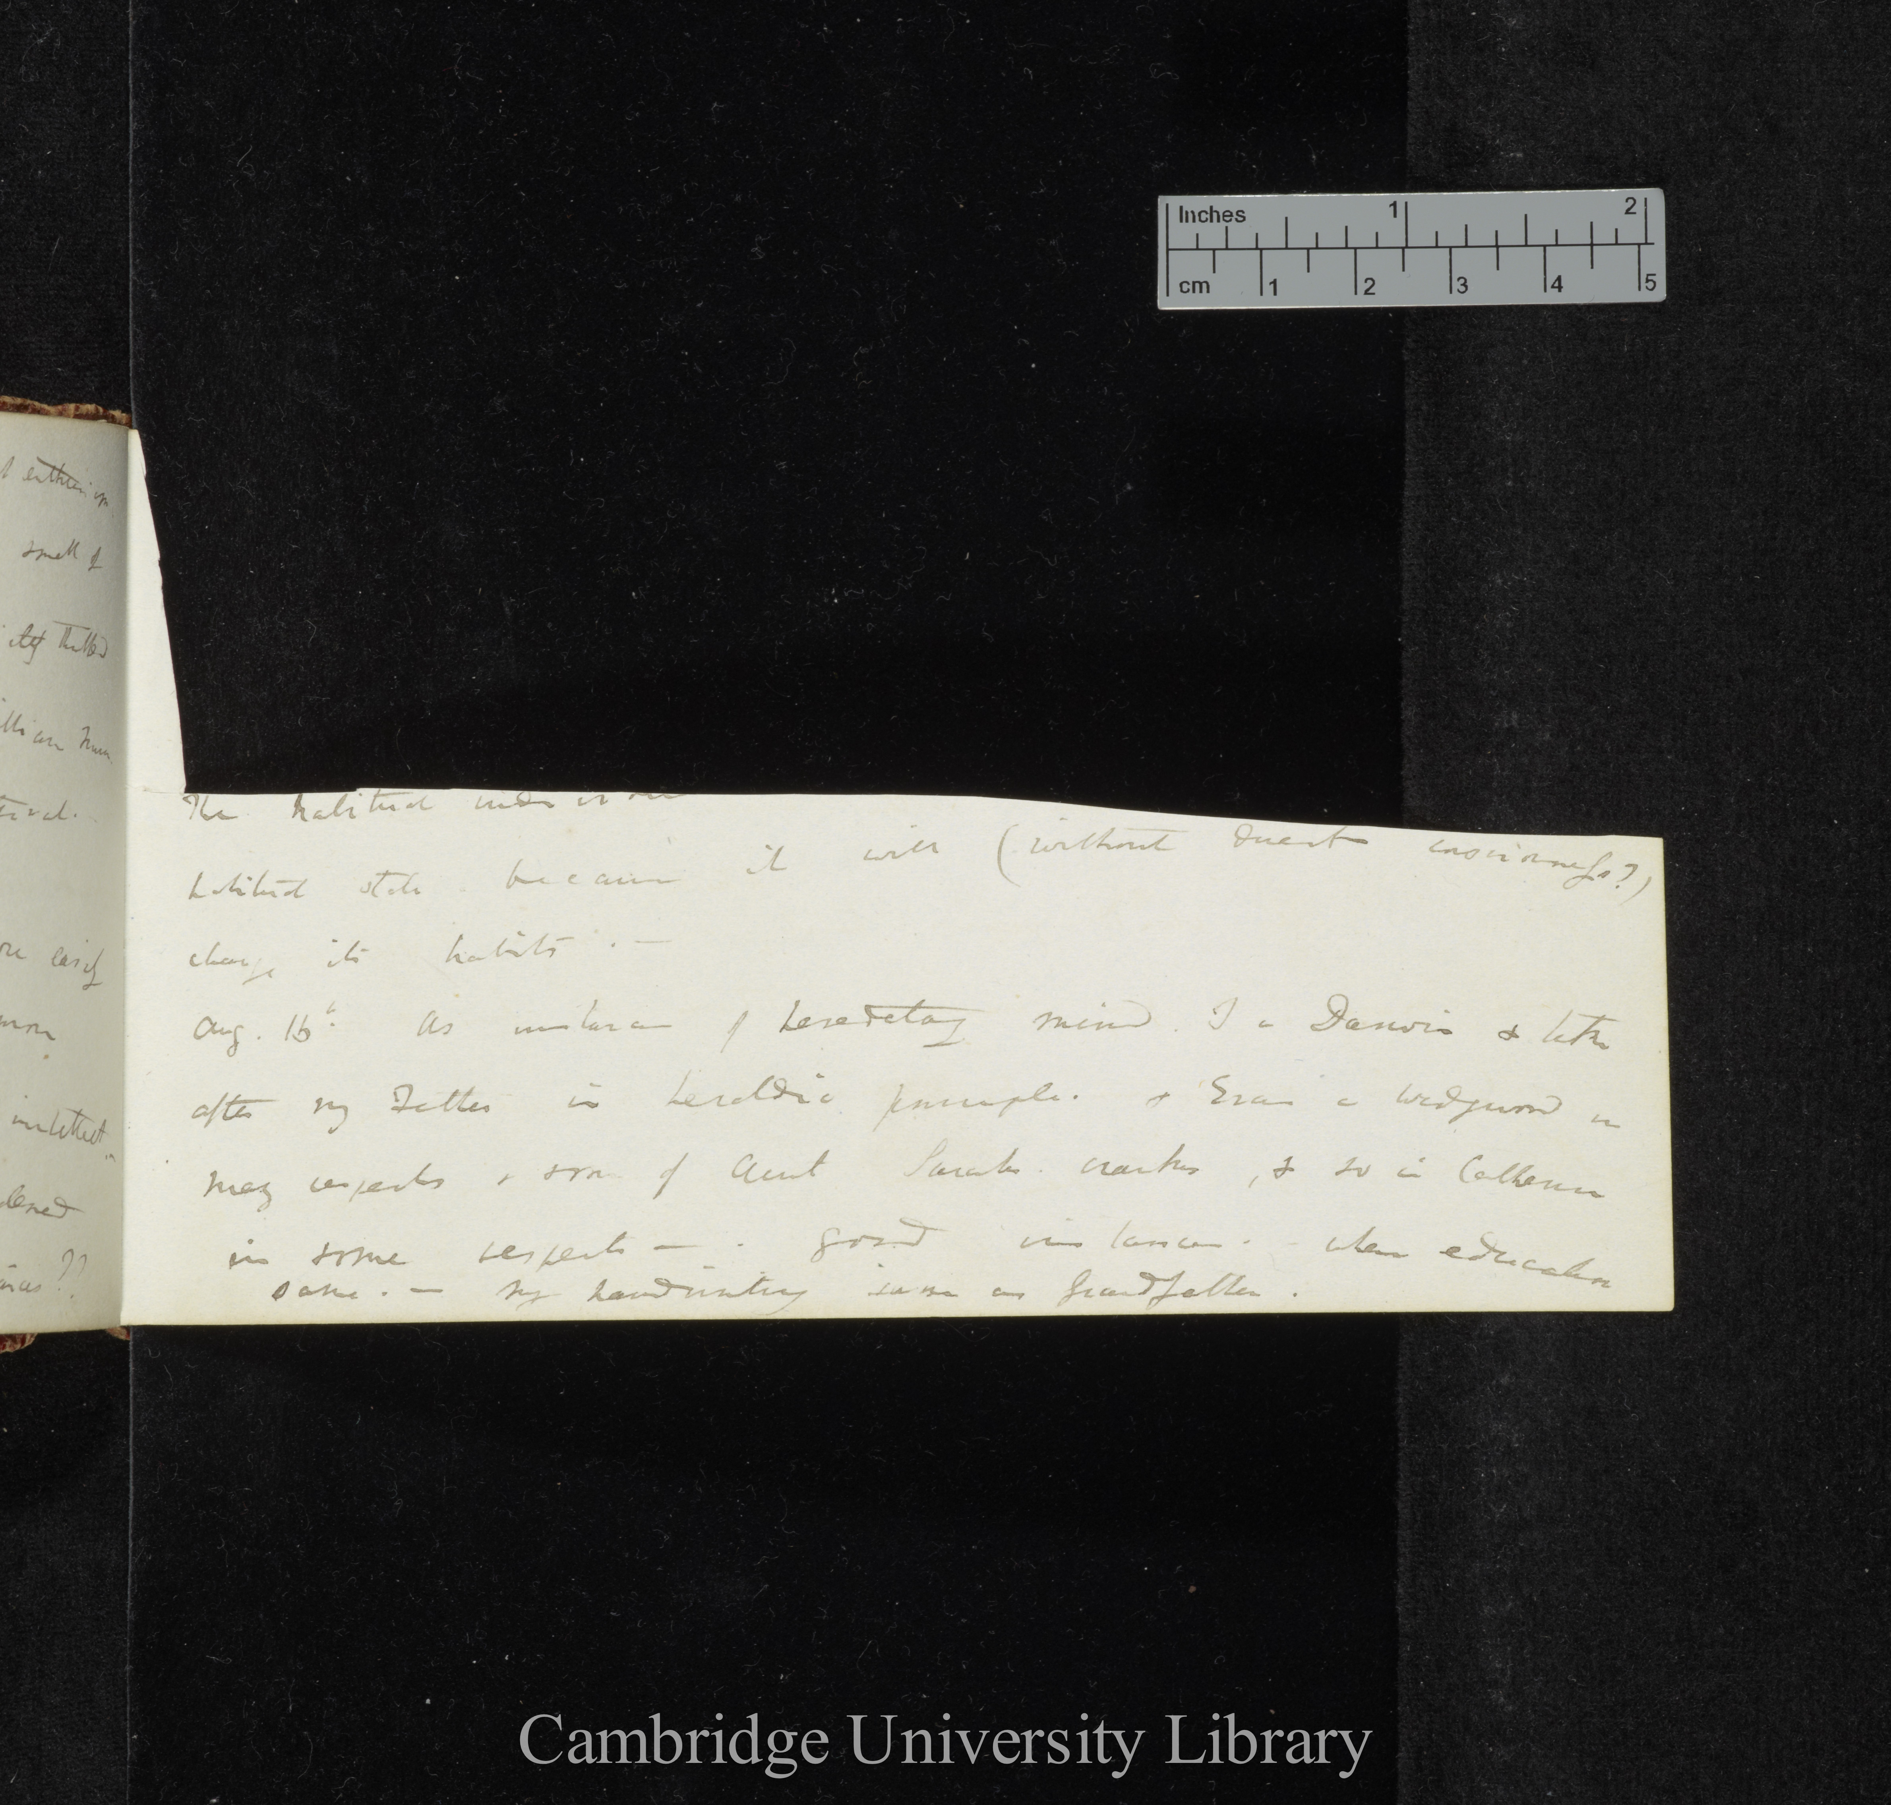
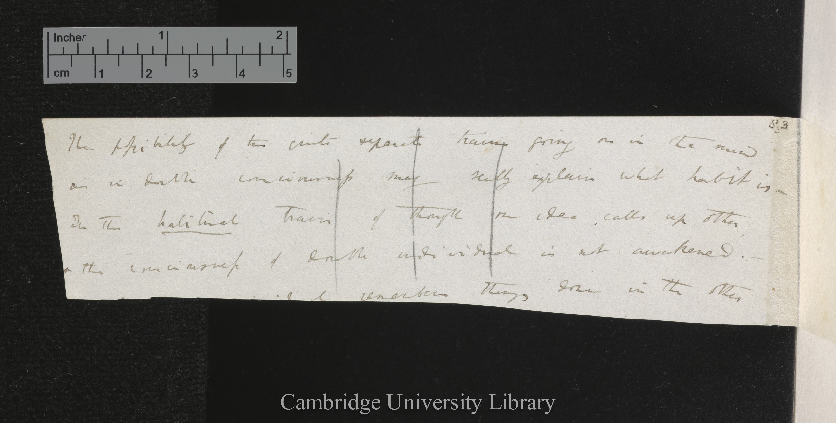
Two matching pieces
Loose note DAR 53.1
Metaphysical Notebook M

Slide 7
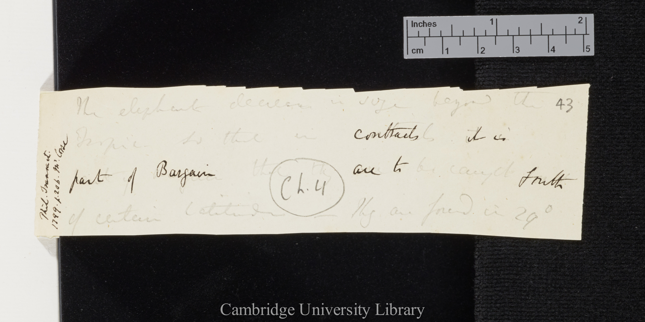
saw-tooth edgege
DAR 45: 43

Slide 8
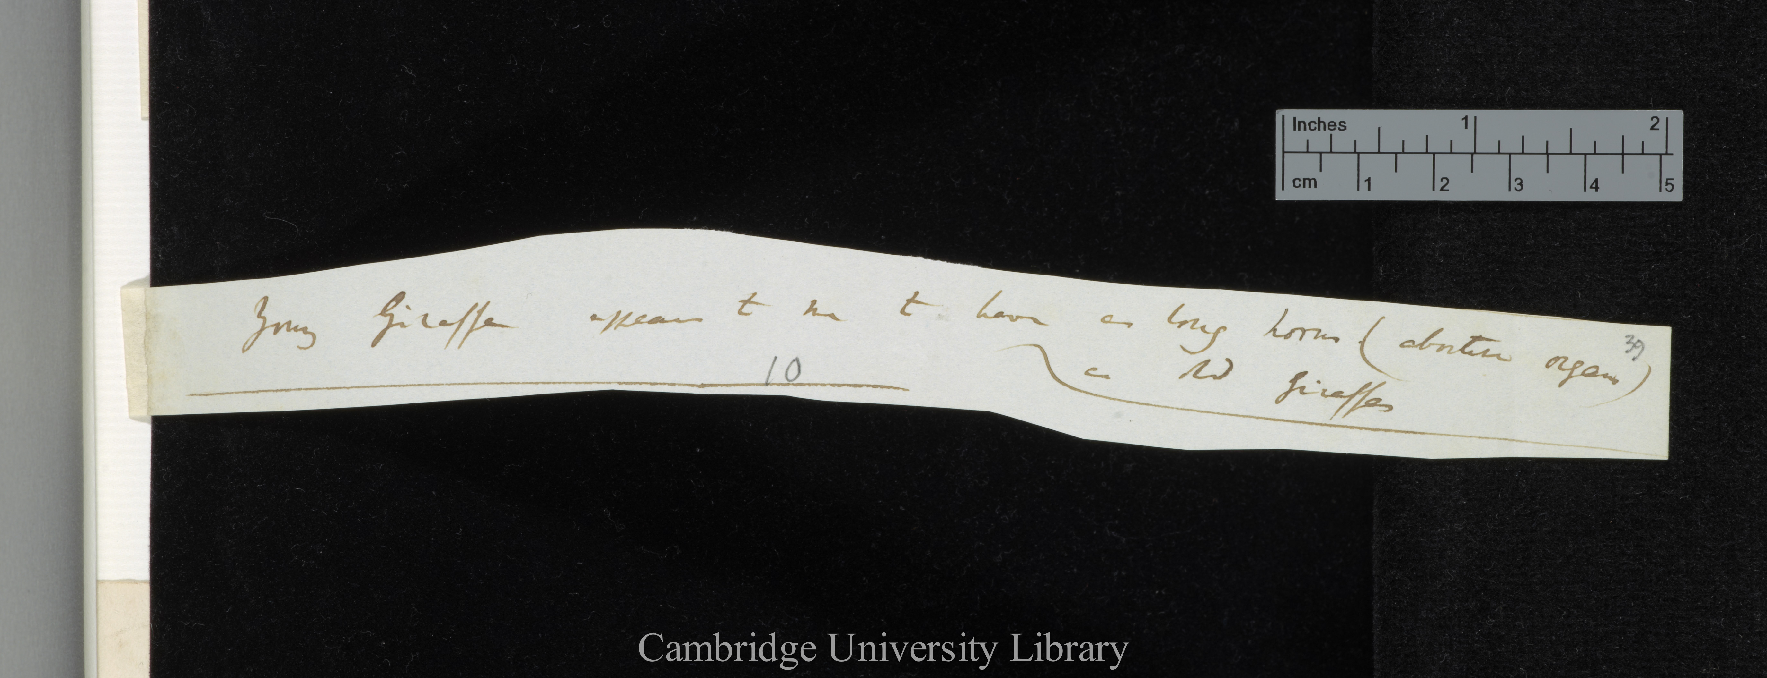
curved cut edge
DAR 205.1: 39

Slide 9
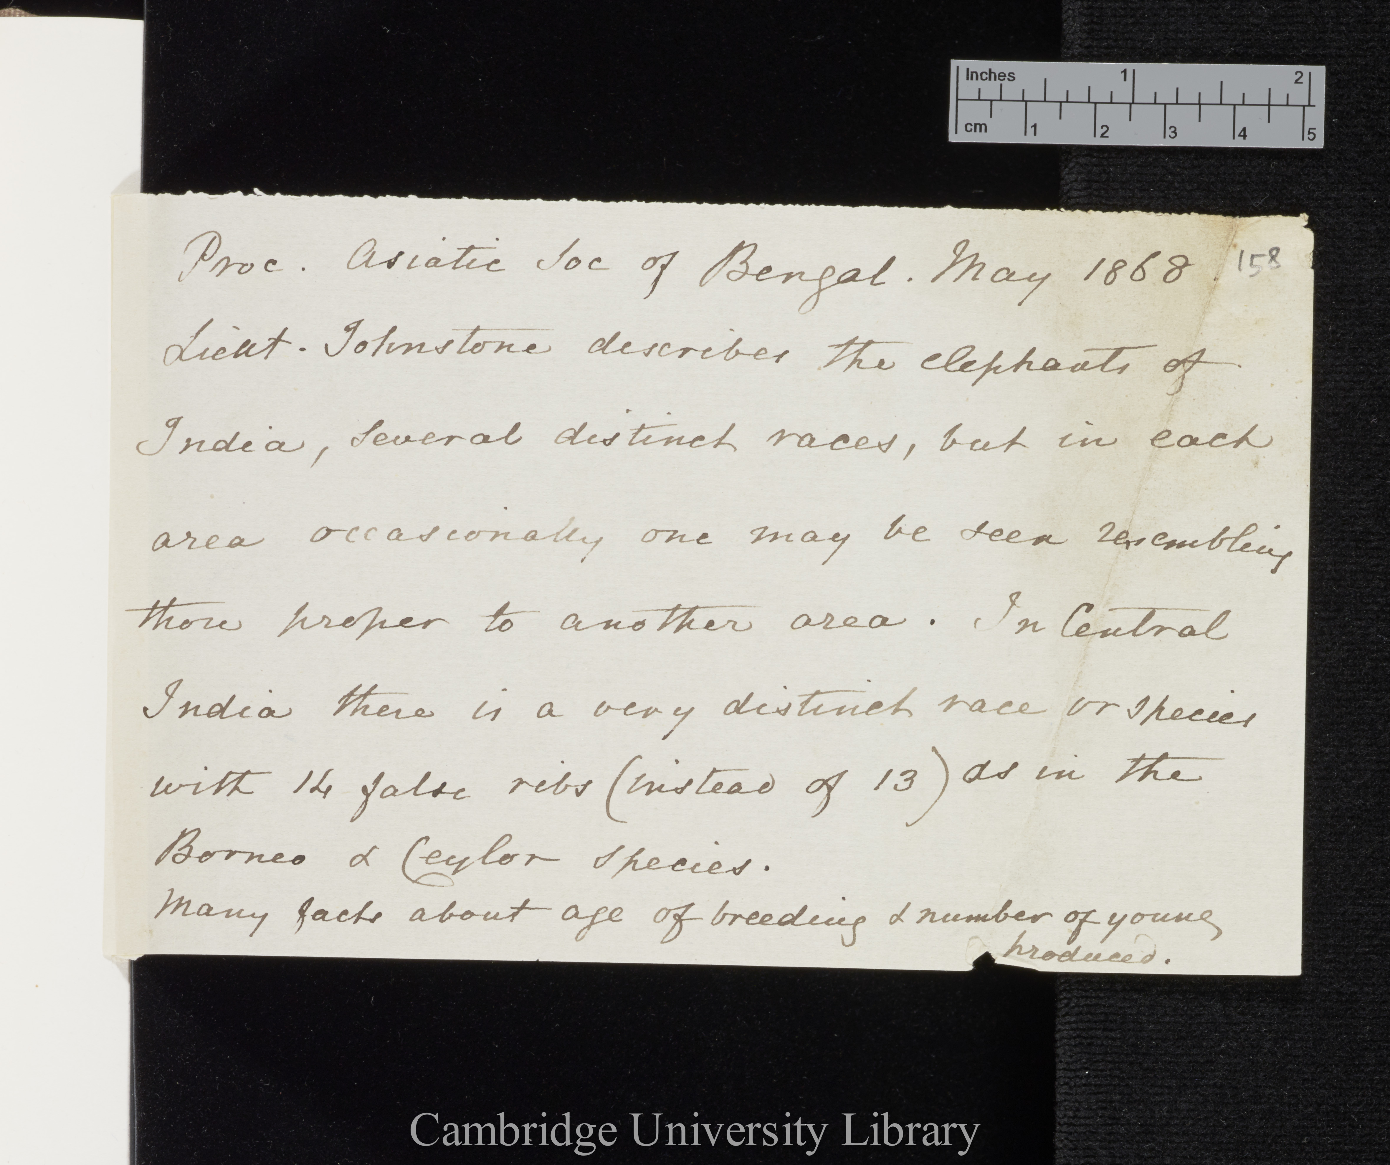
fuzzy edge
tear
DAR 45: 158
DAR 45: 158

Slide 10
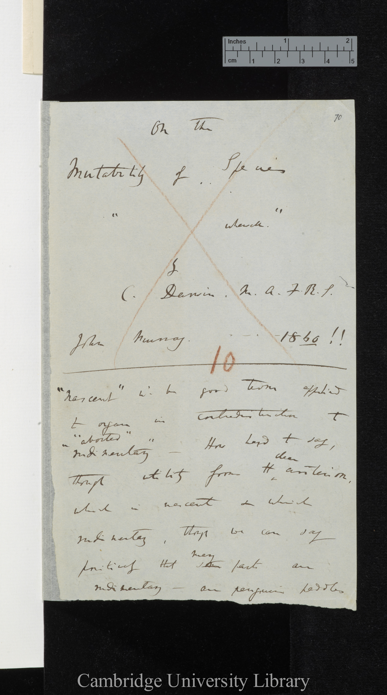
DAR 205.1: 70
fuzzy edge
irregular shape
fuzzy edge detail

Slide 11
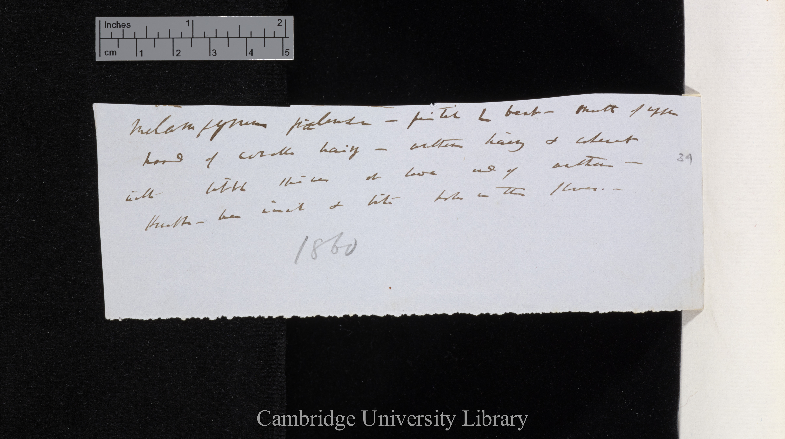
very fuzzy edge

